Slide 1

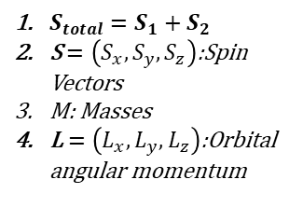




L
$$S_{total}$$
$S_{total}=S_{1}+S_{2}$
S $=\left(S_{x},S_{y},S_{z}\right)$:Spin Vectors
M: Masses
L$=\left(L_{x},L_{y},L_{z}\right)$:Orbital angular momentum
$$S_{1}$$
$$S_{2}$$
$$M_{1}$$
$$M_{2}$$

